Slide 1
ehisa Mrpupah;fNs… ePq;fSk; rpw;gpfs;jhd;!!
Kidth;.j.rptrf;jp uh[k;khs;
cjtpg;Nguhrphpah;
fy;tp cstpay; Jiw
jkpo;ehL Mrphpah; fy;tpapay; gy;fiyf;fofk;
fhug;ghf;fk;, nrd;id – 97.

Slide 2
Mrphpah;
“md;ig Cl;Ltjpy; md;idaha;
mwpit tsh;g;gjpy; Mrhdha;
jtWfis jlbf; Nfl;gjpy; jfg;gdha;
fz;bg;ig fhl;Ltjpy; fhtyuha;
ms;s, ms;s mwpitf; nfhLf;Fk;
ml;raghj;jpukha;, fw;gfj;jpUtha;
gz;Gfis tsh;g;gjpy; gz;ghsuha;”
Mrphpah;fNs ePq;fs; mtjhpf;Fk; ghpkhzq;fs;jhd;
vj;jid! vj;jid!

Slide 3
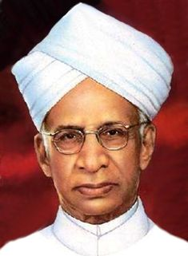
“mwpahikiag; Nghf;fp
mwpTk;, mDgtKk
Nrh;e;J fpilg;gNj Qhdk;”
- lhf;lh;.v]; ,uhjhfpU\;zd;

Slide 4

“ehd; capNuhL ,Ug;gjw;F,
vd; je;ijf;F flikg;gl;bUf;fpNwd; - Mdhy;; rpwg;ghf tho;tjw;F vd;
MrphpaUf;F flikg;gl;bUf;fpNwd;”
- khtPud; mnyf;rhz;lh;

Slide 5
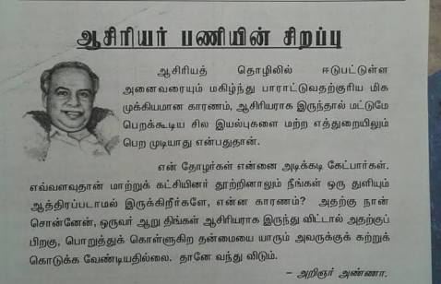
NguwpQh; mz;zh

Slide 6
TEACHER
T - Training - gapw;rp
E - Education - fy;tp
A - Ability - jpwik
C - Creativity - gilg;ghw;wy;
H - Humanism - kdpjk;
E - Efficiency - tpidj;jpwd;
R - Reformer - rPh;jpUj;jthjp

Slide 7
khztr; rpw;gq;fisr; nrJf;Ftjpy; Mrpupa cspfspd; gq;fspg;G
“ruhrhp Mrphpah;
ghlj;ij elj;Jfpwhh;.
rpwe;j Mrphpah;
eilKiw cjhuzq;fNshL fw;gpf;fpwhh;.
cd;djkhd Mrphpah;
capNuhl;lj;ij Vw;gLj;Jfpwhh;.”
- tpy;ypak; My;gh;l;

Slide 8
1. Neh;kiw kdg;ghd;ikia cUthf;Fjy;
Neh;kiw kdg;ghd;ik cilath;fspd; jd;ikfs; (Manifests of Positive Attitude Persons)
Neh;kiw rpe;jid (Positive Tinking)
Mf;fg+h;tkhd rpe;jid (Constructive thinking)
gilg;ghw;wy; rpe;jid (Creative Thinking)
ek;gpf;if (Optimism)
Fwpf;Nfhis mila Cf;fg;gLj;Jjy; (Motivation and Accomplish Goals)
kfpo;r;rpahd kdepiy (An Attitude of Happiness)

Slide 9

Neh;kiw rpe;jid (Positive Tinking) Gj;jh;

Slide 10
Positive Thinker (Neh;kiw rpe;jidAilNahh;)
The Positive thinker
sees the Invisible,
feels the Intangible, and
achieves the Impossible

Slide 11

Mf;fg+h;tkhd rpe;jid (Constructive thinking)

Slide 12
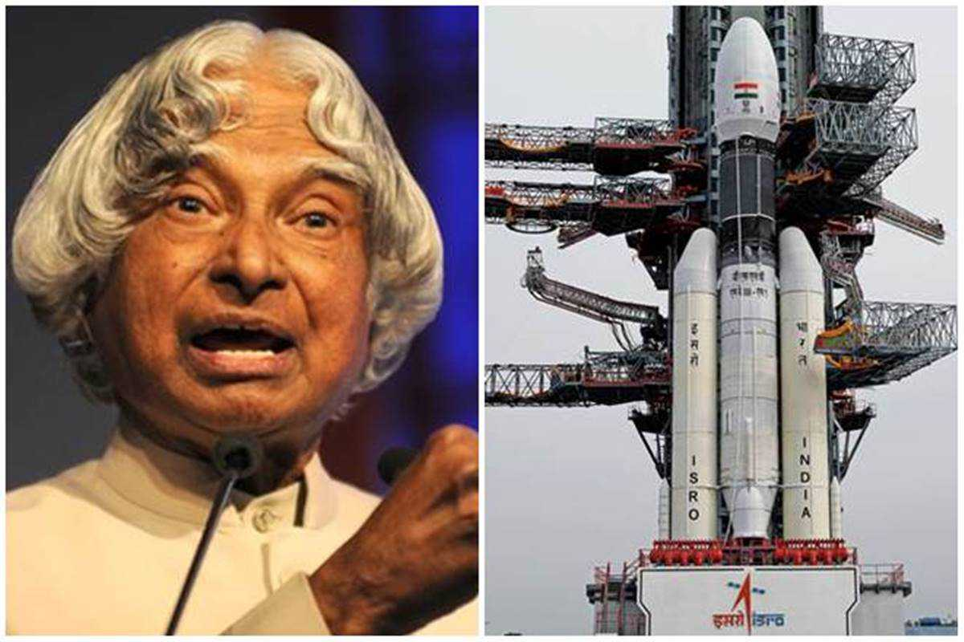
gilg;ghw;wy; rpe;jid (Creative Thinking)

Slide 13
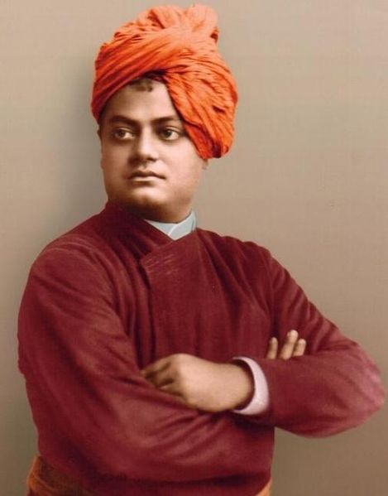
ek;gpf;if (Optimism)
Rthkp tpNtfhde;jh;

Slide 14
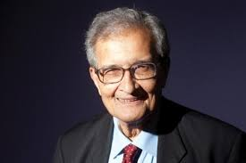
Fwpf;Nfhis mila Cf;fg;gLj;Jjy; (Motivation and Accomplish Goals)
Fwpf;Nfhs; ,y;yhj tho;f;if
Kfthp ,y;yhj fbjj;jpw;F rkk;.
mkh;j;jpah nrd;

Slide 15
Fwpf;Nfhs;fis tFj;Jf; nfhs;Sjy; kw;Wk; xOf;fj;ij Nkk;gLj;Jjy; (Set Principals & Discipline)
tFg;giwapy; ele;Jnfhs;s Ntz;ba gz;Gfisg; Nghjpj;jy;
gs;sp tshfj;jpy; vtw;iw nra;a Ntz;Lk;, nra;af;$lhJ
Fwpj;jNeuj;jpy; Ntiyia Kbj;jy;, Neue;jtwhik
rpwe;j gz;Gs;s khzth;fspd; Fzeyd;fis ghuhl;Ljy;.

Slide 16
kfpo;r;rpfukhd kdepiyia Vw;gLj;Jjy; (An attitude of happiness)
vy;NyhiuAk; nfhz;lhLq;fs;
ey;y ez;gh;fis rk;ghjpAq;fs;
mf;fiwia tsh;j;Jf; nfhs;Sq;fs;
fw;Wf;nfhs;tij epWj;jhjPh;fs;
jil mij cil
epidj;jij Kbf;fTk;
vJ ele;jNjh mJ ed;whfNt ele;jJ
mbf;fb rphpAq;fs;
kd;dpf;f fw;Wf;nfhs;Nthk;

Slide 17
kfpo;r;rpfukhd kdepiyia Vw;gLj;Jjy;
ed;wp nrhy;tJ ed;W
nfhs;ifapy; cWjp Ntz;Lk;
jpahdk; ey;yJ
nra;tij jpUe;jr; nra;
ek;gpf;if mJjhNd vy;yhk;
Mjyhy; mjpfk; md;G nra;tPh;az
Kaw;rpia iftplhjPh;fs;
cq;fsJ rpwg;igf; nfhLq;fs;
ekf;F ehNk ey;yJ
ed;ikNa nra;Nthk;

Slide 18
Neh;kiw kdg;ghd;ikapd; ed;ikfs; (Benefits of Positive Attitude)
rpf;fy;fisj; jPh;f;fpwJ (Solves Problems)
tpRthrj;ij tsh;f;fpwJ (Breeds Loyalty)
FO Ntiyfis tsh;f;fpwJ (Cultivates team work)
MNuhf;fpakhd #oiy cUthf;FfpwJ (Makes Healthy Atmospheres)
kd mOj;jj;ij Fiwf;fpwJ (Reduce Stress)
kfpo;r;rpahd MSik cUthfpwJ (Develops Pleasing Personality)

Slide 19
2. mDjhgj;jpwid Nkk;gLj;Jjy;; (Build Empathy)
,uf;f Fzk;,
fUiz,
kdpjhgpkhdk;
,sk; tajpNyNa cUthf;fp czur;nra;jy;
mDjhgk; nfhz;ltuh ePq;fs;?

Slide 20
1) ePq;fs; jhd; tFg;G yPlh;. rpy Nfs;tpfis fUk;gyifapy; vOjptpl;L, cq;fisnay;yhk; mjw;F gjpy; vOjr; nrhy;yptpl;L, rpwpJNeuk; ntspNa nrd;wpUf;fpwhh; Mrphpah;. xU khzth; mg;NghJ Jhq;fpf; nfhz;bUe;jhy; vd;d nra;tPh;fs;?
m) mtid vOg;gp Nfs;tpfSf;Fg; gjpy; vOjr; nrhy;Ntd;.
M) mtidj; njhlh;e;J Jhq;ftpl;L Mrphpah; te;jJk; fhl;bf; nfhLg;Ngd;.
,) Jhq;fl;Lk; ghtk; mtDf;F tPl;by; vd;d gpur;ridNah!

Slide 21
2) [];f;hPk; filapy; Xh; [];f;hPik thq;FfpwPh;fs;. kPjkpUf;Fk; fhrpy; khiyapy; ,d;ndhU [];f;hPk; rhg;gpl jpl;lkpLfpwPh;fs;. mg;NghJ Vior;rpWtd; xUtd;, ePq;fs; [];f;hPk; rhg;gpLtij Vf;fj;Jld; ghh;f;fpwhd;. vd;d nra;tPh;fs;?
m) tUj;jkhfTk;, Fw;w czh;r;rpNahLk; NtWgf;fkhfj; jpUg;gpf; nfhz;L me;j [];f;hPikr; rhg;gpLNtd;.
M) mnjy;yhk; vd;id ve;jtpjj;jpYk; ghjpf;fhJ.
,) me;j rpWtDf;Fk; Xh; [];f;hPk; thq;fpf;nfhLg;Ngd;.

Slide 22
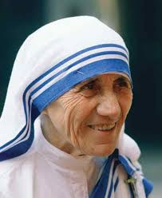
m
md;id njurh

Slide 23
3. Kd;khjphpia Cf;Ftpj;jy; (Encourage role Model)
Neh;kiwahd vz;zk; cilath;fis Kd;khjphpahf
Kd;dpiyg;gLj;Jjy;.
mwptpay; (Science)
,yf;fpak; (Literature)
fzpjk; (Maths)
tuyhW (History)
fiy (Arts)

Slide 24
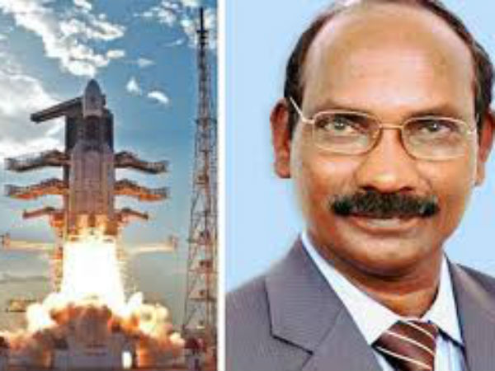
mwptpay; (Science)
,];Nuh jiyth; jkpof tpQ;Qhdp rptd;

Slide 25
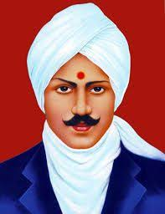
,yf;fpak; (Literature)

Slide 26
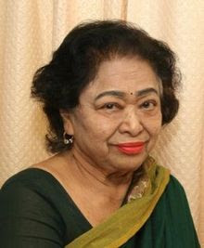
fzpjk; (Mathematics) fzpj Nkij rFe;jyh

Slide 27
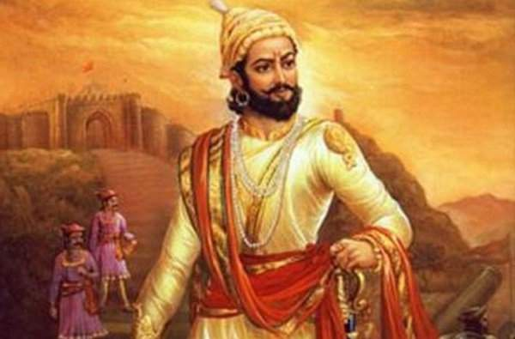
tuyhW (History)

Slide 28
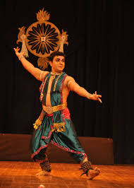
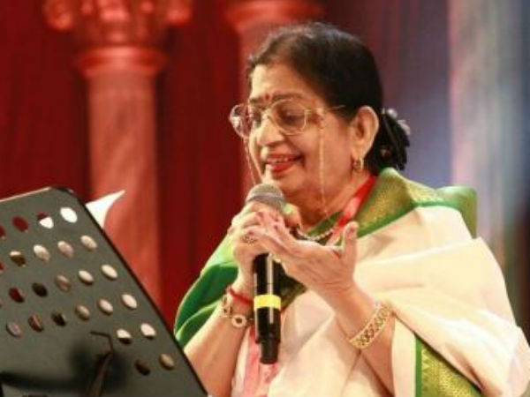
,ir
fpd;d]; rhjid ghlfp RrPyh
eldk;
fiykhkzp [hfph; `PNrd;

Slide 29
3. rpe;jidia nrJf;Fjy;
“rpe;jpf;f njhpe;jtDf;F
MNyhrid Njit ,y;iy
Jd;gq;fis re;jpf;f njhpe;jtDf;F
tho;f;ifapy; Njhy;tpNa ,y;iy”
-

Slide 30
rpe;jidia nrJf;Fjy
vz;zj;jpy; ftdkha; ,Uq;fs;;;;;
Vnddpy; vz;zq;fs;jhd; nrhw;fshfpd;wd.
nrhy;ypy; ftdkha; ,Uq;fs;;;;;
Vnddpy; nrhw;fs;;jhd; nray;fshfpd;wd.
nraypy; ftdkha; ,Uq;fs;;;;;
Vnddpy; nray;fs;jhd; gof;fq;fshfpd;wd
gof;fj;jpy; ftdkha; ,Uq;fs;;;;;
Vnddpy; gof;fq;fs;jhd; xOf;fq;fshfpd;wd.
xOf;fj;jpy; ftdkha; ,Uq;fs;;;;;
Vnddpy; xOf;fk;jhd; cq;fs; tho;it jPh;khdpf;fpd;wJ.
- mUl;je;ij Ntjhj;jphp kfhp\p

Slide 31
4. rpwe;j gz;Gfis fl;likj;jy;
,sikapNyNa rpwe;j gz;Gfis cl;nrYj;Jjy;
Neh;kiwahd nray; cUthf;Fjy;
khzth;fis Cf;Ftpj;jy;
fUj;Jf;fis tpthjpf;fr; nra;jy;

Slide 32
fPo;f;fz;l gz;Gfs; xt;nthU jdpg;gl;l khzth;fspd; MSik Nkk;ghl;L tsh;r;rpf;F Jhz;fshf mikfpd;wd.
khpahij (respect)
guhkhpg;G (care)
nghWg;G (responsibility)
Neh;ik (fairness)
ek;gfj;jd;ik (trustworthiness)
ijhpak; (courage)
tplhKaw;rp (diligence)
xUikg;ghL (Integration)

Slide 33
5. MSikia Nkk;gLj;Jjy
gs;sp – Mrphpah;, khzth;, MSik tsh;r;rp
MrphpaUf;F rthy;
khztUf;F kpfg;nghpa tha;g;G
KO MSik – gs;sp Kf;fpag;gq;F
Rje;jpuk;, khpahij kw;Wk; ,uf;fj;ij fw;Wj;jUjy;
ngw;NwhUf;F mLj;j epiy
Mrphpah; Kd; khjphp
gs;sp KbtpYk; xOf;fk; kw;Wk; epajp filg;gpbj;jy;;

Slide 34
5. MSikia Nkk;gLj;Jjy; (Personality Development)
khpahijia typAWj;Jjy; (Insist on Respect)
cly; nkhopapd; ntspg;ghL (Body Language)
Mil czh;T (Dressing Sense)
nray;fs; NgRfpd;wd (Actions Speak)
milnkhopiaj; jtph;f;fTk;
NfSq;fs; (Listen)
md;gpdhy; jpUj;Jq;fs; (Punish Lovingly)

Slide 35
7. Cf;Ftpj;jy; (Motivation)
“Cf;Ftpf;f MspUe;jhy;
Cf;Ftpf;Fk; Ms;$lj;
Njf;F tpw;ghd;”
-ftpQh; thyp

Slide 36
8. jd;dk;gpf;ifia tsh;j;jy; (Development of Self Confidence)
“cd; if Nuifia ghh;j;J
vjph;fhyj;ij eph;zapj;J tplhNj……
Vndd;why;
ifNa ,y;yhjtDf;F $l vjph;fhyk; cz;L”

Slide 37
9. topfhl;Ljy; (Guidance)
Mrpah; vd;gth; fw;gpg;gth;.
FU vd;gth; fw;W top epd;W khzth;fSf;F topfhl;Lgth;.
“vq;F elg;gLfpd;whNah mq;F kyuhF”
Fw;f;Nfhs; ,y;yhj khzt tho;f;if, Kfthpapy;yh fbjj;jpw;F rkk;.
tFg;giw
khWgl;l Fzq;fs;, Njhw;wq;fs;, elj;ijfs;, rpe;jidfs; vd;w ,dpa fyit midj;Jk; Xhplj;jpy;.
Mk; mJjhd; tFg;giw

Slide 38
10. ftiyg;gLtij epWj;Jq;fs;! thoj; Jtq;Fq;fs;;! (Stop Worrying! Start Living)
vjph;fhyj;ijg; gw;wp ftiy nfhs;shjpUj;jy;;
epfo; fhyj;ij re;Njh\khf thoj; Jtq;Fjy;
Nkhrkhd .#o;epiyapid kdhPjpahf Vw;Wf;nfhs;sy;
gpur;rpid jPutpy;iyah?
ftiyg;gLtjhy; kl;Lk; xU gpur;rpid jPh;e;J tpLkh?
ftiyiaj; Jhf;fp vwpjy;;

Slide 39
11. rpwe;j rpw;gpahfj; jpfo rpy MNyhridfs; (How to make Good Sculptors)
vq;Nf vg;NghJ, vg;gb NgRjy;Ntz;Lk;
cuf;f NgRtij jtph;j;jy;
gpwUld; NgRtjw;F jaf;fk; fhl;lhjpUj;jy;
MSik vd;gJ Gw mofpy; ,y;iy vd;gij epidtpy; nfhs;sy;
ghpTilatuhfTk;, md;G epiwe;jtuhfTk; ,Uj;jy;;
mikjpahfTk;, Gj;jprhypj;jdj;NjhLk; ,Uj;jy;;
Kul;Lj;jdkpf;ftuhfTk;, mjpf $r;rypLgtuhftk; ,Uj;jy; $lhJ
cq;fis ePq;fNs re;Njfpf;fhjpUj;jy;
cq;fs; cilapy; ftdk; nrYj;Jjy;;
cq;fSf;nfd jdpg;gl;l ghzpia cUthf;fpf; nfhs;sy;;
Nghyr;nra;ahjpUj;jy;

Slide 40
12. ntw;wp ngw;w Mrphpar; rpw;gpfspd; milahsq;fs;
fbd ciog;G kw;Wk; epiyahd jd;ik (Hard work and Consistency)
Neh;kiwahd kdg;ghd;ik ( Positive attitude)
tplh Kaw;rp (Keep trying)
ftdk; kw;Wk; cWjpg;ghL (Focus and Determination)
Kiwahd jpl;lkply; kw;Wk; nray;ghL (Strategic planning and deliverance)
jd;dk;gpf;if (Self-confidence)
Neu Nkyhz;ik (Time management)
nray;gLj;Jk; Kiw (Practical)
Neh;kiwahd rpe;jid (Positive Thinking)

Slide 41
tho;f;ifapy; ntw;wp ngw %d;W topfs;
“gpwiuf;fhl;bYk; mjpfkhf
mwpe;J nfhs;s KaYq;fs;”
“gpwiuf;fhl;bYk; mjpfkhf
ciof;ff; fw;Wf;nfhs;Sq;fs;”
“gpwiuf; fhl;bYk; Fiwthf
gpwhplkpUe;J ngw KaYq;fs;”
-tpy;ypak; N\f;];gpah;

Slide 42
The Choice is Yours
“With a Bad Attitude
You Can Never have a Positive day”
“With a Positive Attitude
You Can never have a Bad day”

Slide 43
Be SLIM No FAT
F = Fear and Frustration - gak; kw;Wk; tpuf;jp
A = Anxiety and Anger - ftiy kw;Wk; Nfhgk;
T = Tension - gjw;wk;
S = Self – Confidence - jd;dk;gpf;if
L = Love - md;G
I = Initiative - Kaw;rp
M = Moderation - epjhdk;

Slide 44
Positive “WATCH”
W = Words - thh;j;ijfs;
A = Actions - nray;fs;
T = Thoughts - rpe;jidfs;
C = Characters - gz;Gfs;
H = Heart - md;ghd ,jak;

Slide 45
Neh;kiwahd kdg;ghd;ik cUthtjw;fhd topfs; (That is the Way to Positive Attitude)
Start the day with Love
Spend the day with Love
Fill the day with Love
End the day with Love

Slide 46
ehisa Mrphpa rpw;gpfNs! tho;j;Jf;fs;!
“ek; ehl;il eph;zapf;fg; NghFk;
khztr;rpw;gq;fspd;
ey; tho;tpw;Fk;, tsh;r;rpf;Fk;
topfhl;lg; NghFk; tho;tpay; Gj;jfq;fNs!
ehisa Mrphpar; rpw;gpfNs!
cq;fis tho;j;JNtd; epj;jKNk!”

Slide 47
midtUf;Fk; kpf;f ed;wp
Kidth; j.rptrf;jp uh[k;khs;
cjtpg; Nguhrphpah;
fy;tp cstpay; Jiw
jkpo;ehL Mrphpah; fy;tpapay; gy;fiyf;fofk;
fhug;ghf;fk;, nrd;id – 97.

